Slide 1
Designing a Web Page with CSS
Creating a Web Site for a Rural Farm

Slide 2
Case: Sunny Acres
Tammy Nielsen and her husband, Brent, live and work at Sunny Acres, a 200-acre farm near Council Bluffs, Iowa.
Tammy created a Web site for Sunny Acres several years ago to make information about the farm easily accessible to her customers. The Web site has become outdated, so Tammy would like to enliven it with a new design based on the latest elements and styles from HTML and CSS. Tammy’s knowledge of HTML and Web styles is limited, so she’s come to you for help in creating a new look for the Sunny Acres Web site.

Slide 3
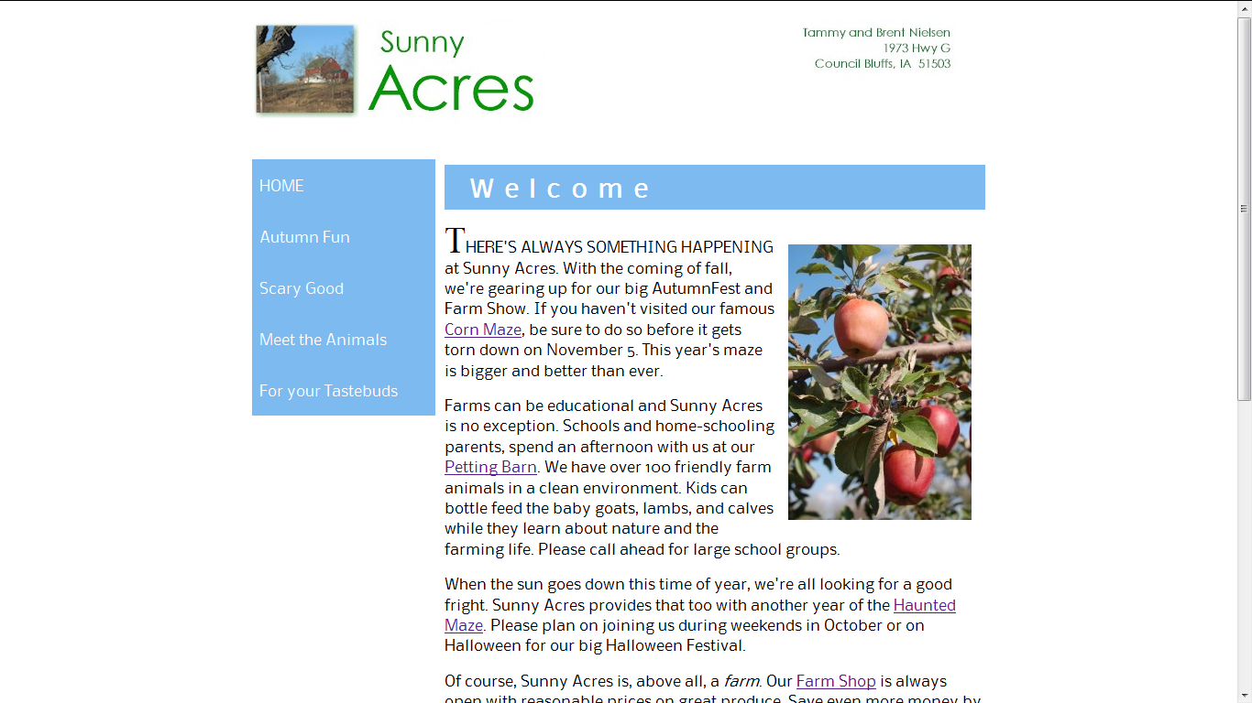
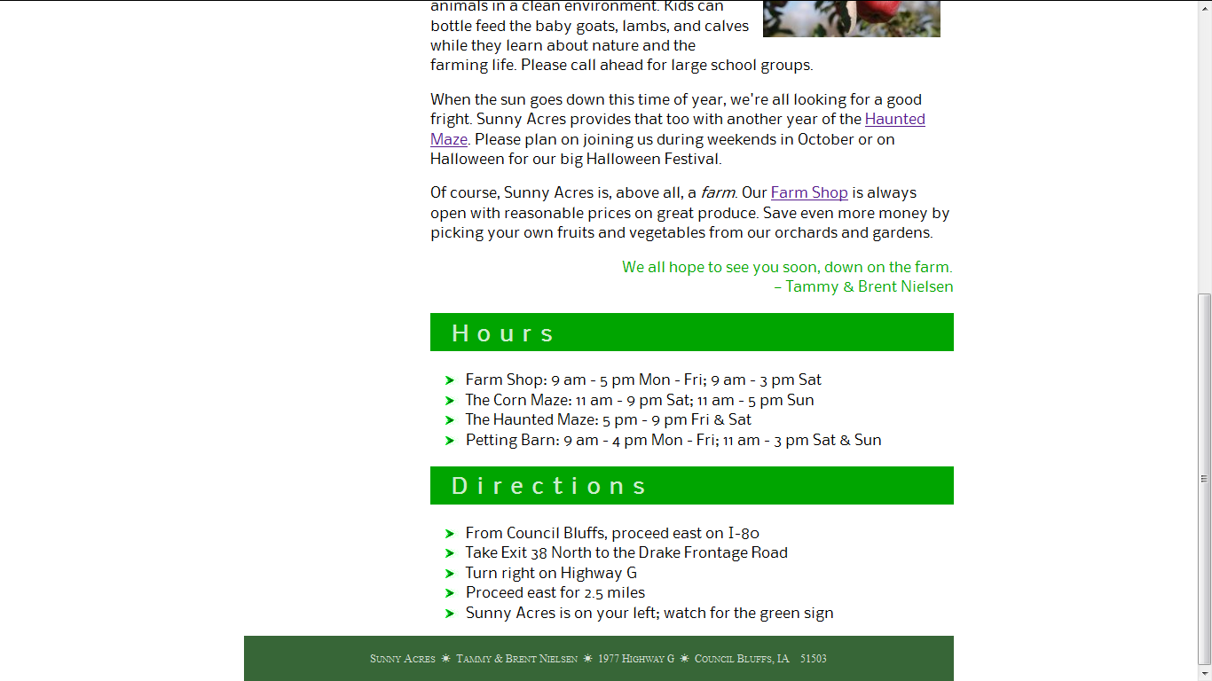

Slide 4
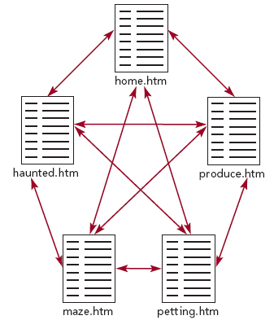
Introduction
Pages that you will work with:
home.htm – the home page, describing the operations and events sponsored by the farm
maze.htm – a page describing the farm’s corn maze
haunted.htm – a page describing the farm’s annual Halloween Festival and haunted maze
petting.htm – a page describing the farm’s petting barn
produce.htm – a page describing the Sunny Acres farm shop and the pick-your-own produce garden

Slide 5
Use your text editor to open the haunttxt.htm, hometxt.htm, mazetxt.htm, pettingtxt.htm, and producetxt.htm files, located in the tutorial.03\tutorial folder included with your Data Files. Within each file, go to the comment section at the top of the file and add your name and the date in the space provided. Save the files as haunted.htm, home.htm, maze.htm, petting.htm, and produce.htm, respectively, in the same folder.
Take some time to review the HTML code within each document so that you understand the structure and content of the files.
Open the home.htm file in your Web browser, and then click the links at the top of the page to view the current appearance of the haunted.htm, maze.htm, petting.htm, and produce.htm files.

Slide 6
The History of CSS
You learned in Tutorial 1 that HTML specifies a document’s content and structure, but not how that document should be rendered. To render a document, the device displaying the page needs a style sheet that specifies the appearance of each page element. The style sheet language used on the Web is the Cascading Style Sheets language, also known as CSS.
The specifications for CSS are maintained by the World Wide Web Consortium (W3C); and as with HTML and XHTML, several versions of CSS exist with varying levels of browser support.
With CSS, as with HTML, Web page designers need to be aware of compatibility issues that arise not just among different versions of the language, but also among different versions of the same browser. Although it’s tempting to always apply the latest and most exciting features of CSS, you should not create a situation where users of older browsers will not be able to view your Web pages.

Slide 7
Defining a Style Rule
The general syntax of a CSS style rule is
selector {
property1: value1;
property2: value2;
property3: value3;
...
}
h1 {
color: blue;
text-align: center;
}
h1, h2, h3, h4, h5, h6 {
color: blue;
text-align: center;
}

Slide 8
Link to the layout style sheet
Return to the home.htm file in your text editor.
Directly above the closing </head> tag, insert the following link element
<link href=”sa_layout.css” rel=”stylesheet” type=”text/css” />
Save your changes to the file.
Reopen the home.htm file in your browser. The layout of the page has been altered using the design styles present in the sa_layout.css file.

Slide 9
Start creating the sa_styles.css style sheet
Use your text editor to open the blank text file sa_stylestxt.css from the tutorial.03/tutorial folder. Save the file as sa_styles.css.
At the top of the file, insert the following style comments:
/*
Sunny Acres Style Sheet
Author: your name
Date: the date
*/
Return to the home.htm file in your text editor.
Directly below the link element for the sa_layout.css file, insert the following:
<link href=”sa_styles.css” rel=”stylesheet” type=”text/css” />
Save your changes to the file.

Slide 10
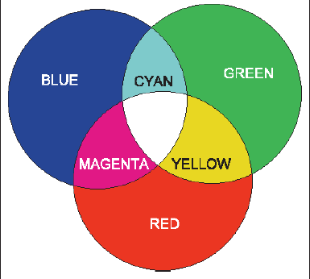
RGB Color Values
A color value is a numerical expression that describes the properties of a color. To better understand how numbers can represent colors, it can help to review some of the basic principles of color theory and how they relate to the way colors are rendered in a browser.
In classical color theory, all colors are based on adding three primary colors – red, green, and blue – at different levels of intensity.
CSS represents these intensities mathematically as a set of numbers called an RGB triplet, which has the format rgb(red, green, blue)

Slide 11
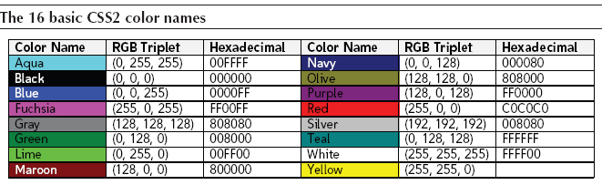
Using Color Names
If you don’t want to use color values, you can also specify colors by name. CSS supports the 16 basic color names
Sixteen colors are not a lot, so most browsers support an extended list of 140 color names, including such colors as orange, crimson, khaki, and brown. Although this extended color list was not part of the CSS specification until CSS3, most browsers support it.

Slide 12
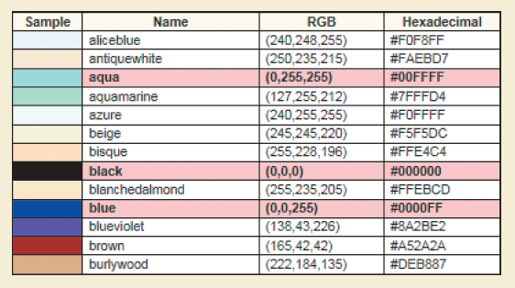
A partial list of extended color names

Slide 13
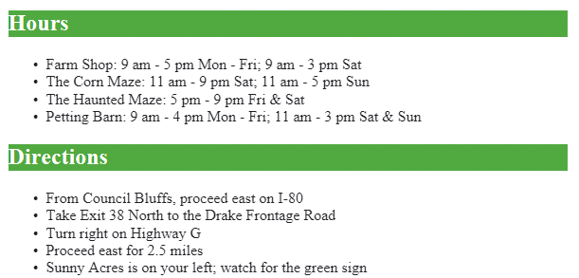
Format the text and background colors
Return to the sa_styles.css file in your text editor
Directly below the style comments, insert the following style rules
/* Body styles */
body {
background-color: white;
}
/* Heading styles */
h2 {
background-color: rgb(0, 165, 0);
color: white;
}

Slide 14
HSL Color Values
The RGB color model is only one way of describing colors. CSS3 also supports the Hue Saturation Lightness (HSL) model that describes colors based on hue, saturation, and lightness. Hue is the tint of the color and is based on the color’s location on the color wheel. Hue values range from 0° up to 360°, where 0° matches the location of red on the color wheel, 120° matches green, and 240° matches blue. Saturation measures the intensity of the chosen color and ranges from 0% (no color) up to 100% (full color). Finally, lightness measures the brightness of the color and ranges from 0% (black) up to 100% (white). Color values using the HSL model are described in CSS3 using
hsl(hue, saturation, lightness)
where hue is the tint of the color in degrees, saturation is the intensity of the color in percent, and lightness is the brightness of the color in percent. Next figure shows how setting the hue to 38°, the saturation to 90%, and the lightness to 60% results in a medium shade of orange.

Slide 15
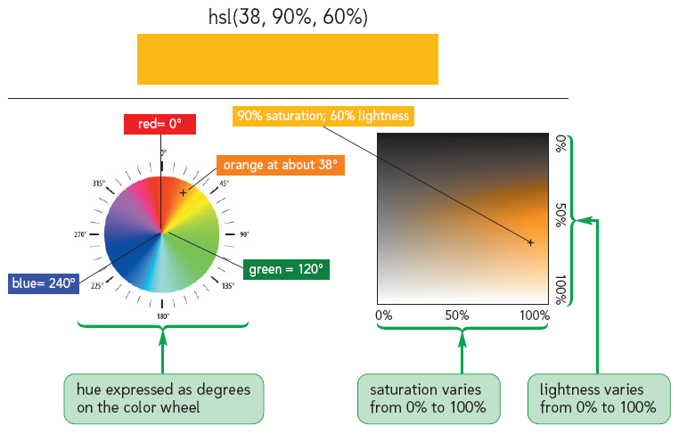

Slide 16
Opacity Values in CSS3
CSS3 also allows page designers to augment RGB and HSL color values by specifying a color’s opacity. Opacity defines how much of the colors below the surface of the current object show through to affect its appearance. The opacity of a color can be specified using either of the following rgba and hsla color values
rgba(red, green, blue, opacity)
hsla(hue, saturation, lightness, opacity)
where opacity sets the transparency of the color as a decimal ranging from 0 (completely transparent) up to 1.0 (completely opaque). For example, the following style displays the text of h1 headings in a medium shade of orange at 70% opacity:
hsla(38, 90%, 60%, 0.7)

Slide 17
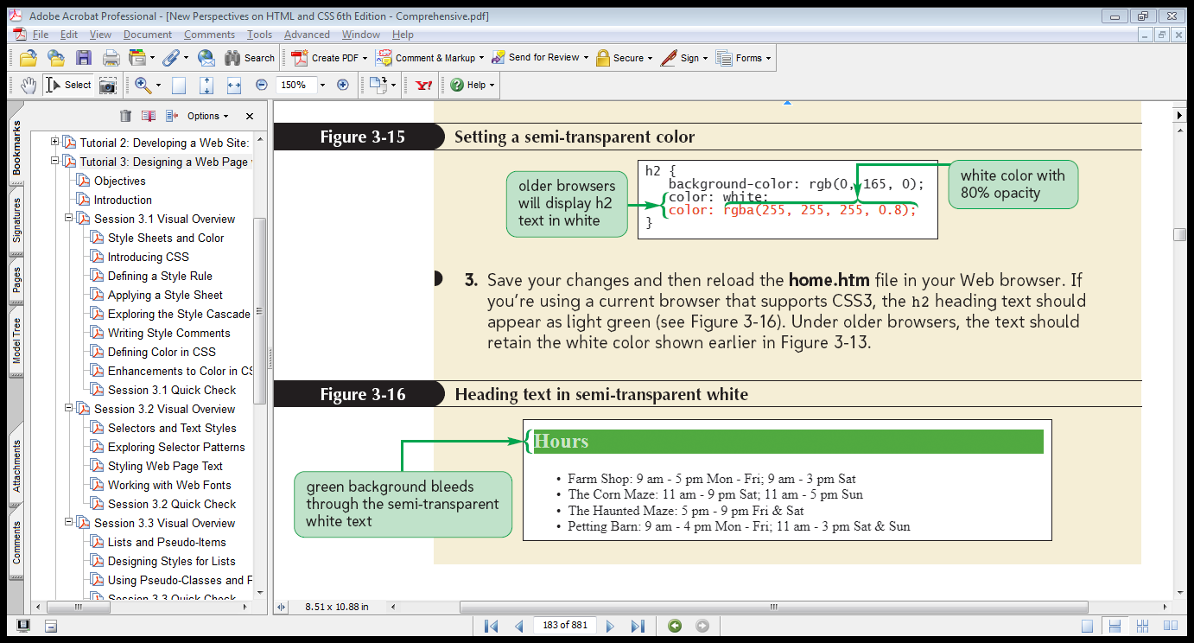
Make the heading text semi-transparent
Return to the sa_styles.css file in your text editor.
Within the style rule for the h2 selector, insert the following color property: color: rgba(255, 255, 255, 0.8);

Slide 18
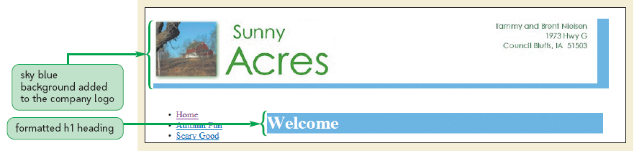
Format h1 headings
Return to the sa_styles.css file in your text editor.
Directly above the style rule for h2 headings, insert the following style rule, as :
h1 {
background-color: rgb(125, 186, 240);
color: white;
}

Slide 19
Contextual Selectors
So far, the only selectors you’ve studied involve either single elements or groups of elements in a comma-separated list. However, this approach doesn’t take into account that Web pages are structured documents in which elements are nested within other elements, forming a hierarchy of elements.
Contextual selectors take advantage of the general rule that the more specific style is applied in preference to the more general. For instance, the styles
section h1 {color: red;}
h1 {color: blue;}
would result in any h1 heading text nested within a section element appearing in red, even though the last style sets the text color to blue. The more specific style using the contextual selector takes precedence over the general style in which no context has been given.

Slide 20
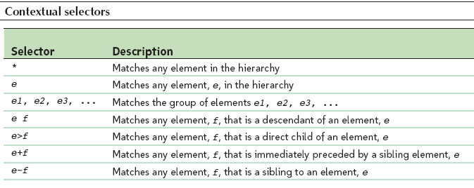
For example, the style rule
* {color: blue;}
uses the asterisk (*) selector—also known as the wildcard selector—to select all elements in the document. The result is that the text of all elements in the document appears in blue. On the other hand, the rule
p > em {color: blue;}
applies the blue text color only to emphasized text placed as a direct child of a paragraph.

Slide 21
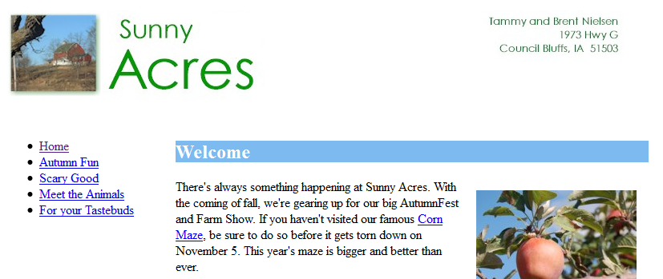
Revise the style sheet
Return to the sa_styles.css file in your text editor.
Change the selector for the h1 heading rule to section h1
Save your changes to the style sheet and then reload the home.htm file in your Web browser. Verify that the sky blue background is applied only to the Welcome heading.

Slide 22
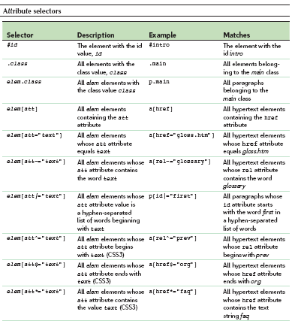
Attribute Selectors

Slide 23
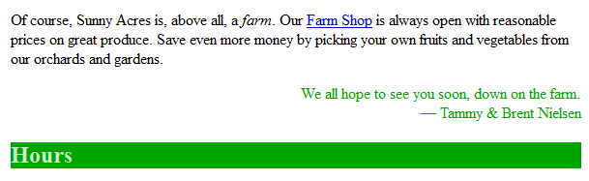
Create a style based on the class attribute
Return to the sa_styles.css file in your text editor.
Add the following style rule at the bottom of style sheet:
/* Section styles */
section p.closing {
color: rgb(0, 165, 0);
text-align: right;
}
Save your changes to the style sheet and then reload the home.htm file in your Web browser. Verify that the text of the last paragraph appears in green and is right-aligned on the page.

Slide 24
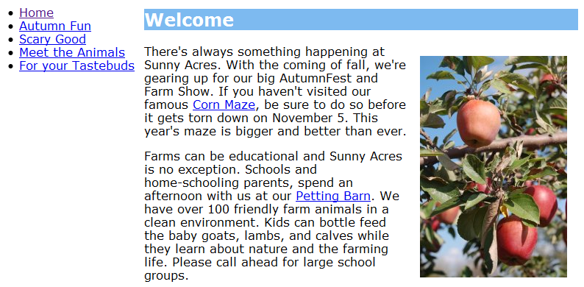
Apply a sans-serif font to the body text
Return to the sa_styles.css file in your text editor.
Add the following style to the body style rule at the top of the style sheet:
font-family: Verdana, Geneva, sans-serif;
Save your changes to the style sheet and then reload the home.htm file in your Web browser.

Slide 25
Set the font size of the h1 headings
Return to the sa_styles.css file in your text editor.
Add the following style to the style rule for h1 headings in the section element:
font-size: 1.7em;
Save your changes to the file and then reload the home.htm file in your Web browser. Verify that the font size of the h1 heading appears slightly smaller under the revised style sheet.

Slide 26
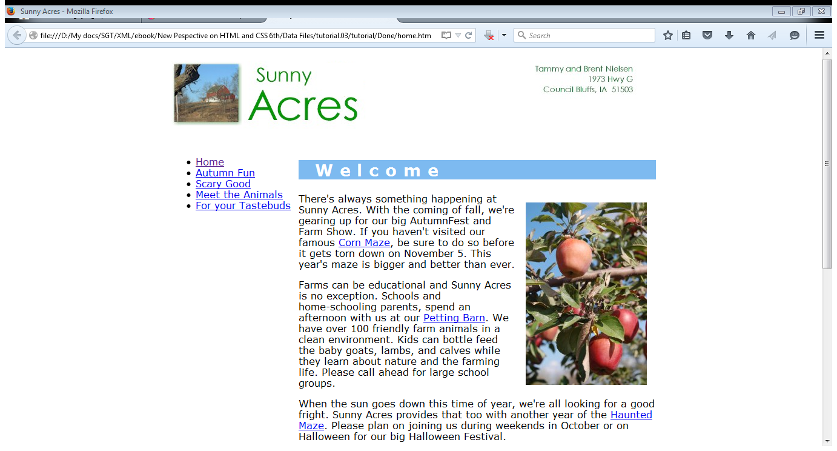
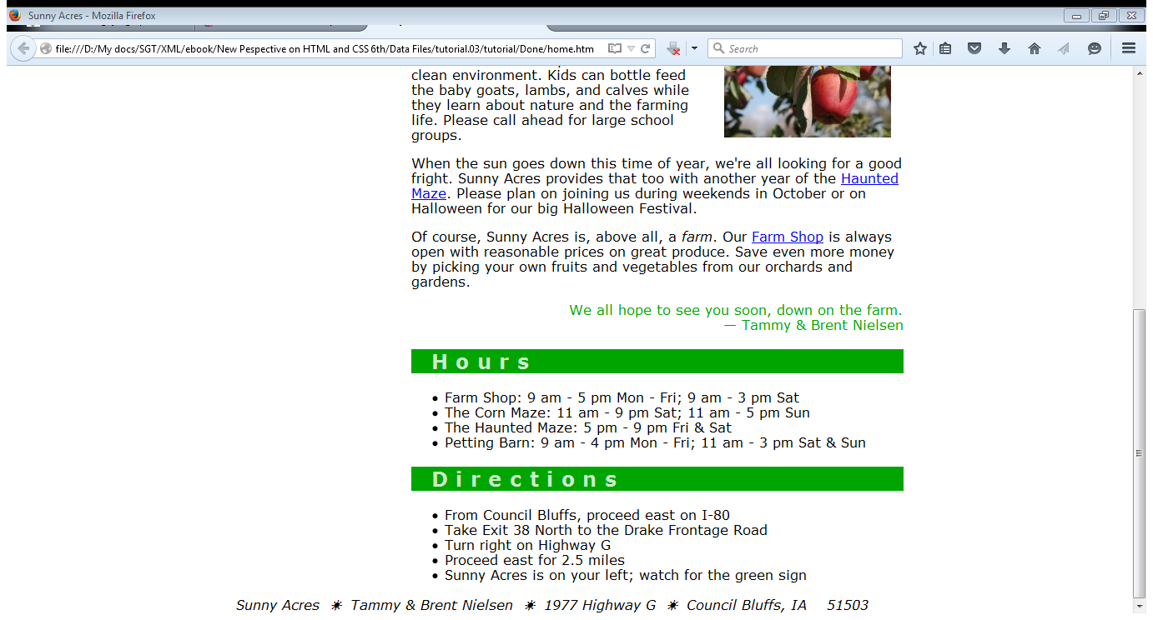
Change the spacing of the headings on the Web site
Return to the sa_styles.css file in your text editor.
Within the style rules for the section h1 selector and the h2 selector, insert the following style values:
letter-spacing: 0.4em;
text-indent: 1em;
Save your changes to the file and then reload the home.htm file in your browser. The indent and the spacing between the letters have increased.

Slide 27
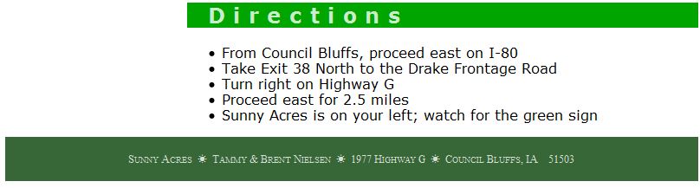
Change the style of the address element
Return to the sa_styles.css file in your text editor. At the bottom of the style sheet, add the following style rule for the address element nested within the footer element:
/* Footer styles */
footer address {
background-color: rgb(55, 102, 55);
color: white;
color: rgba(255, 255, 255, 0.8);
font: normal small-caps 0.8em/4em 'Times New Roman', Times, serif;
text-align: center;
}
Save your changes to the file and then reload the home.htm file in your Web browser. Scroll to the bottom of the page and verify that the style of the address element has been changed

Slide 28
Working with Web Fonts
Text design on the Web largely has been limited to a few Web safe fonts that are supported by all major browsers. It would be better if a browser would automatically download whatever fonts are required for a Web page in the same way it downloads images.
To access and load a Web font, you add the rule
@font-face {
font-family: name;
src: url(url) format(text);
descriptor:value;
descriptor:value;
…
}
to the style sheet, where name is the name assigned to the Web font, url is the location of the font definition fi le, text is an optional text description of the font format, and the descriptor:value pairs are optional style properties that describe how and when the font should be used.

Slide 29
Insert and apply the NobileRegular font
Using your text editor, open the nobile.txt text file located in the tutorial.03/tutorial folder.
Copy the @font-face rule located at the top of the file.
Return to the sa_styles.css file in your text editor.
Paste the copied text of the @font-face rule into your style sheet directly above the style rule for the body element. Next, you’ll revise the style rule for the body element so that it uses the NobileRegular font as the first option, if available and supported by the browser. You’ll also set the line height of body text to 1.4 em and the line height of the page headings to 1.8 em to accommodate the metrics of this new font.
Within the font-family property for the body element, insert NobileRegular followed by a comma and a space, at the beginning of the font list.
Add the property line-height: 1.4em; to the style rule for the body element and line-height: 1.8em; to the style rules for the h1 and h2 elements.

Slide 30
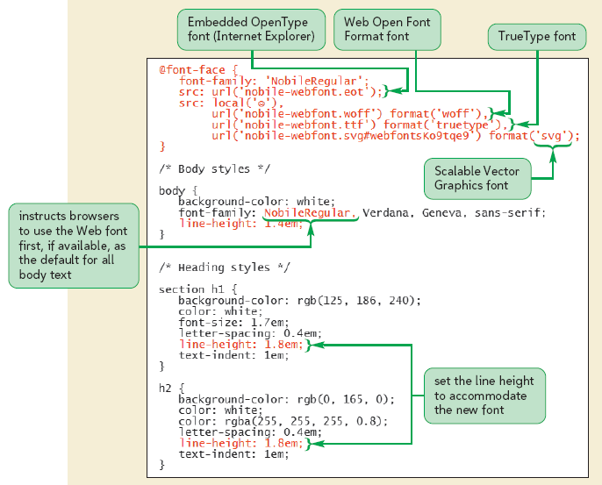

Slide 31
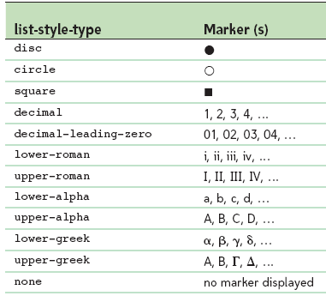
Designing Styles for Lists
To change the marker displayed in ordered or unordered lists, you apply the style
list-style-type: type;
where type is one of the markers discussed

Slide 32
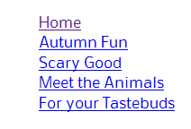
Remove the bullets from the navigation links
Return to the sa_styles.css file in your text editor.
Directly below the style rule for the h2 element, insert the following :
/* Navigation list styles */
nav ul {
list-style-type: none;
}
Save your changes to the file and then reload the home.htm file in your Web browser. Verify that the bullet markers have been removed from the items in the navigation list.

Slide 33
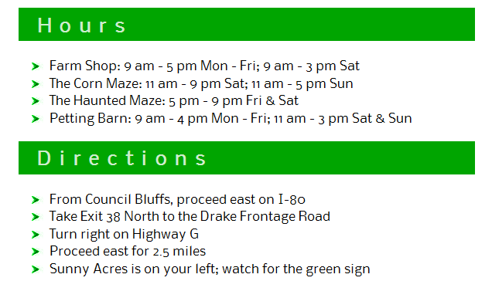
Use an image for a list bullet
Return to the sa_styles.css file in your text editor.
Directly below the style rule for the closing paragraph, insert the following:
section h2+ul {
list-style-image: url(arrow.png);
}
Save your changes to the file and then reload the home.htm file in your Web browser.

Slide 34

Move the navigation list to the left
Return to the sa_styles.css file in your text editor.
Within the style rule for the navigation list, insert the following style value: padding-left: 0.5em;
Save your changes to the file and then reload the home.htm file in your Web browser. Verify that the entries in the navigation list have been shifted to the left, aligned roughly with the left edge of the Sunny Acres logo.

Slide 35
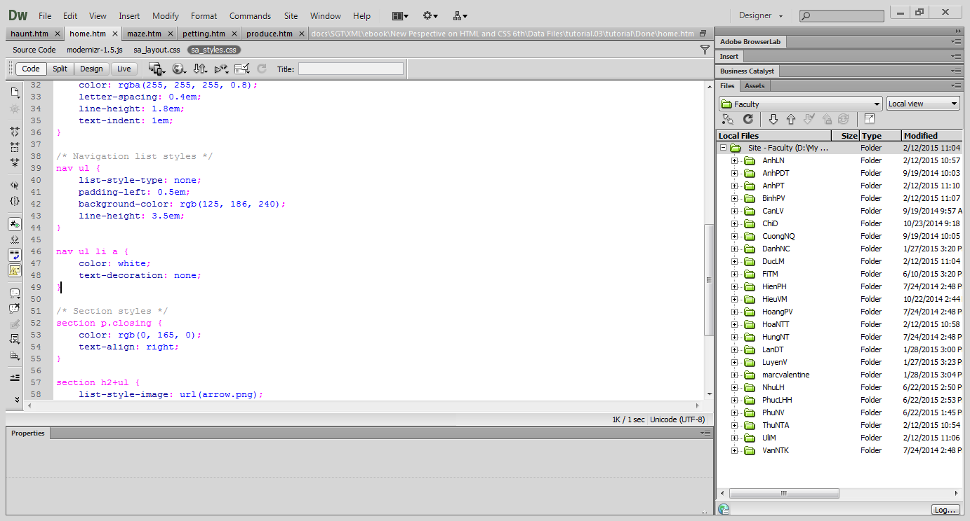
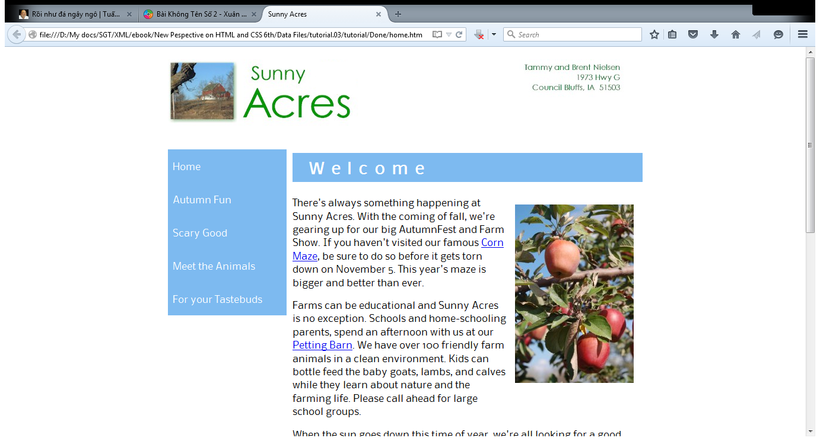
Reformat the navigation list
Return to the sa_styles.css file in your text editor.
Add the following style properties to the nav ul style rule
background-color: rgb(125, 186, 240);
line-height: 3.5em;
Directly below the nav ul style rule, add the following rule for navigation hypertext links:
nav ul li a {
color: white;
text-decoration: none;
}

Slide 36
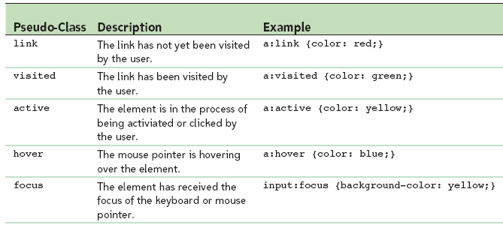
Using Pseudo-Classes and Pseudo-Elements
Without underlines, there is no visual clue that the links in the navigation list act as hypertext. Web sites in which links are underlined or highlighted only when the mouse pointer hovers over the linked text. This type of effect is called a rollover effect because it is applied only when a user “rolls” the mouse pointer over an element.

Slide 37
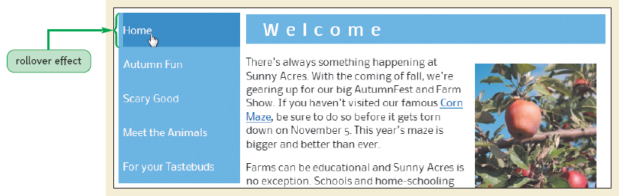
Apply the hover pseudo-class
Return to the sa_styles.css file in your text editor.
Add the following style rule:
nav ul li:hover {
background-color: rgb(83, 142, 213);
}

Slide 38
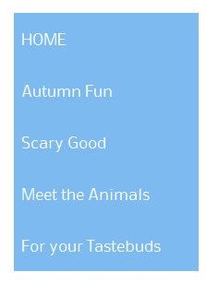
Transform the text of the first navigation list element
Return to the sa_styles.css file in your text editor.
Add the following style rule:
nav ul li:first-of-type {
text-transform: uppercase;
}

Slide 39
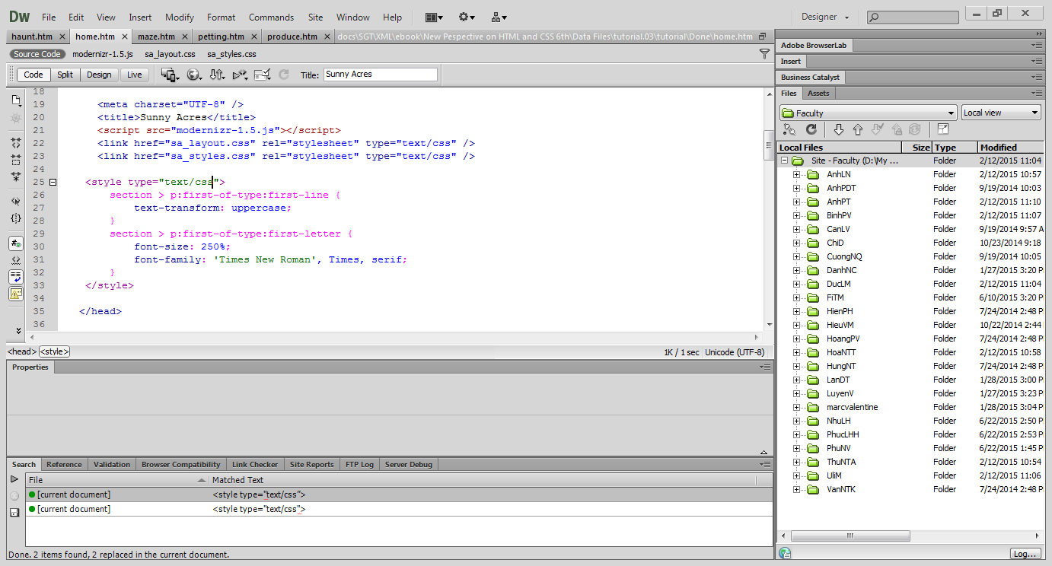
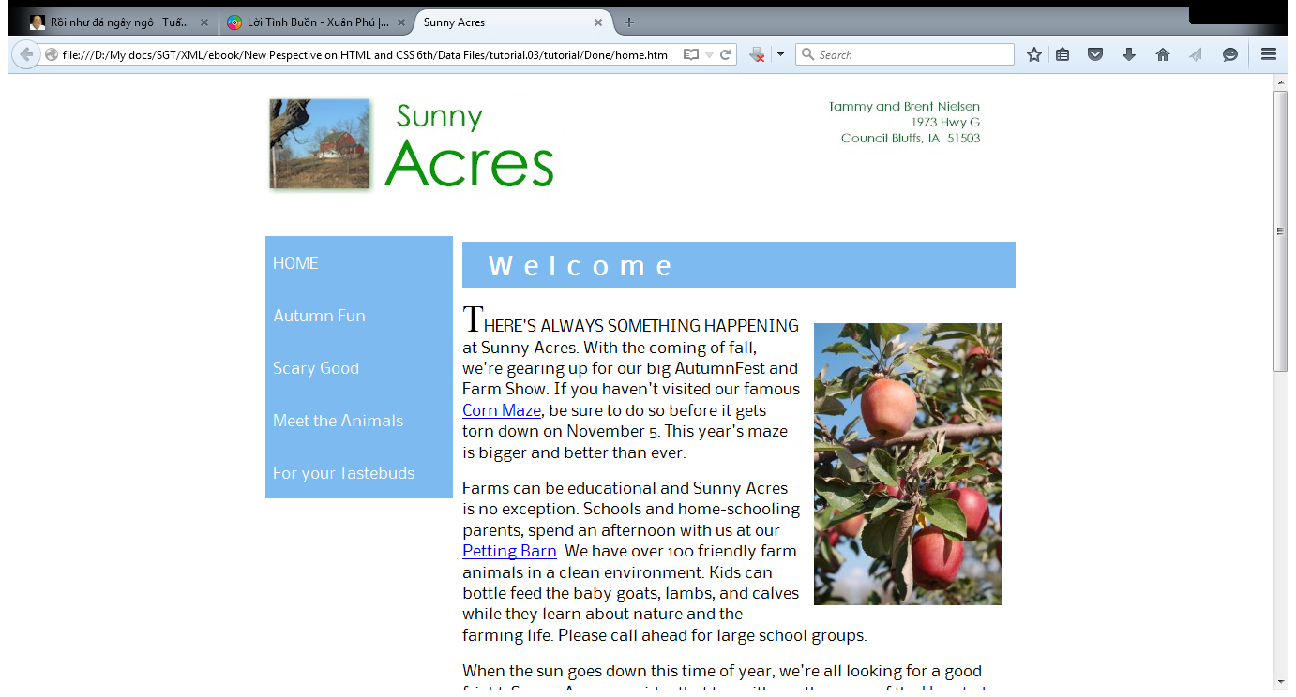
Create the initial cap and first line styles
Go to the home.htm file in your text editor.
Directly above the closing </head> tag, insert the following code:
<style type=”text/css”>
section > p:first-of-type:first-line {
text-transform: uppercase;
}
section > p:first-of-type:first-letter {
font-size: 250%;
font-family: 'Times New Roman', Times, serif;
}
</style>

Slide 40
Apply the style sheet to the other pages on the site
Go to the maze.htm file in your text editor.
Directly above the closing </head> tag, insert the following link elements and embedded style sheet:
<link href=”sa_layout.css” rel=”stylesheet” type=”text/css” />
<link href=”sa_styles.css” rel=”stylesheet” type=”text/css” />
<style type=”text/css”>
section h1 {
background-color: rgb(191, 141, 101);
}
</style>
Repeat Step 2 for the haunted.htm, petting.htm, and produce.htm files. Set the h1 background colors for these three files to rgb(0, 0, 0), rgb(133, 109, 85), and rgb(50, 69, 99), respectively.

